Slide 1

Hunger in America
Ann Rumsey

Slide 2
Capstone project
Link to Git Hub
Link to Power BI
Link to Tableau

Slide 3
Agenda
Tools used Python, Tableau, Excel
Power BI (correlation plot R package)
Data sets from USDA (United States Department of Agriculture)
SNAP - Supplemental Nutrition Assistance Program
Food expenditures
Census data and projections

Slide 4
Unemployment trends 2000 to April 2020
Demographic ribbons
Men vs. Women over 20 and Teens
Interactive trends and rank

Slide 5
The first National Food Stamp program
Established in 1939 to combat hunger during high unemployment
"We got a picture of a gorge, with farm surpluses on one cliff and under-nourished city folks with outstretched hands on the other. We set out to find a practical way to build a bridge across that chasm."
(Milo Perkins, the Food Stamp program’s first administrator)

Slide 6
From Food Stamps to SNAP – Supplemental Nutrition Assistance Program
Food Stamp program re-established in 1964 for a half-million recipients that first year, going nationwide in 1974 and growing to 22 million in 1981,
Electronic benefit access in 1984, and peaking at 47 million in 2013,
Declining to the current level with 37 million SNAP recipients in February 2020.

Slide 7
USDA Food and Nutrition Service Federally assisted food programs
School Lunch program (NSLP) established in 1946, with the National School Lunch Act providing nutritionally balanced, low-cost or free lunches to children each school day in public and nonprofit private schools and residential childcare institutions
School Breakfast Program (SBP) provides reimbursement to states to operate nonprofit breakfast programs in schools and residential childcare institutions.
The Child and Adult Care Food Program (CACFP) is a federal program that provides reimbursements for nutritious meals and snacks to eligible children and adults who are enrolled for care at participating childcare centers, day care homes, and adult day care centers.
The Special Milk Program (SMP) provides milk to children in schools and childcare institutions who do not participate in other federal meal service programs.
From <https://www.fns.usda.gov/cn>

Slide 8
SNAP - Supplemental Nutrition Assistance Program
Participant Counts by year 1970-April 2020 (National in 1974)
Average Monthly Benefits per person
Total Benefit dollars in Millions
Administrative Cost percent (includes state administrative fees)

Slide 9
Child Nutrition programs
NSLP School Lunch
SBP School Breakfast
Summer Meals
SMP Milk half-pints
CACFP Childcare / Adult care programs
By state
https://schoolnutrition.org/AboutSchoolMeals/SchoolMealTrendsStats/

Slide 10
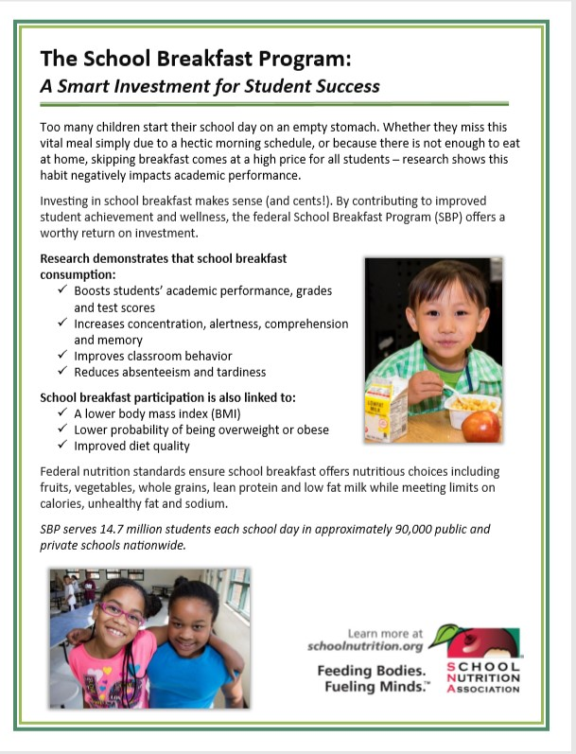
Child Nutrition Programs
NSLP - Nearly 100,000 schools/institutions serve school lunches to 29.8 million students each day,
SBP - Over 90,000 schools/institutions serve school breakfasts to 14.71 million students each day,
Reimbursement Rates for the 2019-20 School Year:
Free School Lunch $3.41 (avg cost to produce $3.81)
Free School Breakfast $1.84 (avg cost to produce $2.72)
These programs are accumulating debt from both the cost of producing meals (45% Labor / Benefits) and from children unable to pay the subsidized cost if ineligible for free meals.
https://schoolnutrition.org/AboutSchoolMeals/SchoolMealTrendsStats/

Slide 11
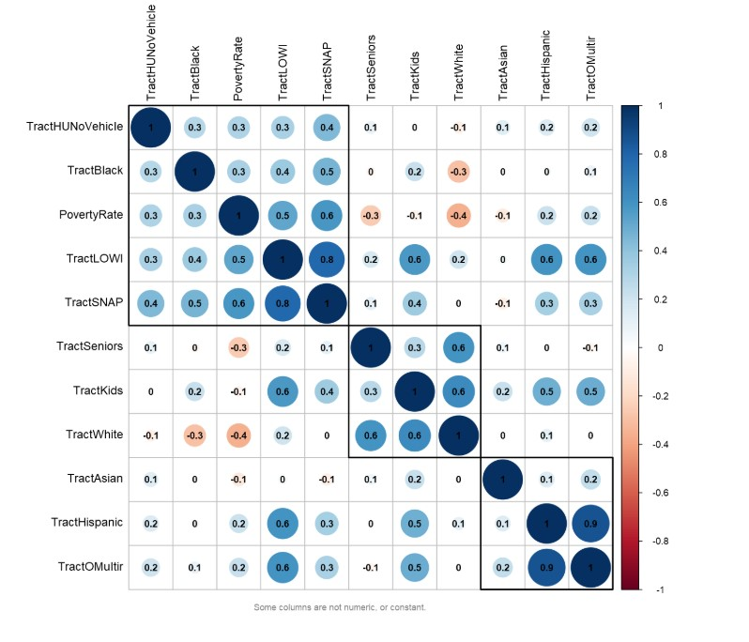
Demographics from the 2010 Census
The 2020 Census is in progress and VERY important. In Power BI using an R package this interactive chart shows *National and by *State correlation between Census tract population:
LOWI (low income) &
SNAP (supplemental Nutrition Benefit recipients

Slide 12
Food away from Home trends

Slide 14
Poverty and Median Family Income

Slide 16
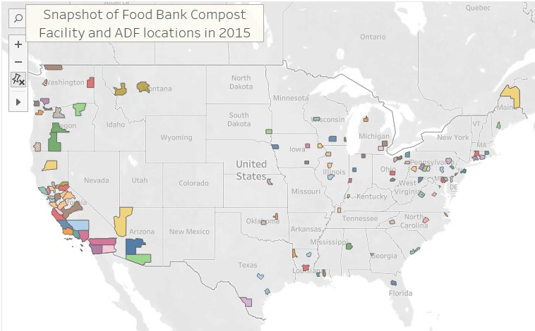
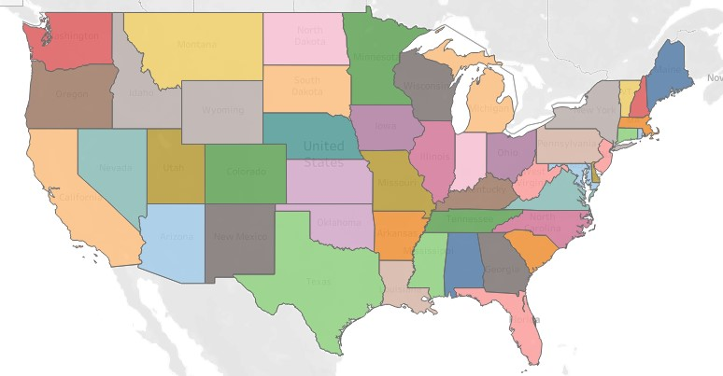
Tableau Geo and State Maps
Local organizations and Food recipients' quick views
Tableau interactivity allows for quick visuals for multiple data points across a large table.
By State meals served to support Child Nutrition
By County Food Banks and Excess Food
LINK

Slide 17
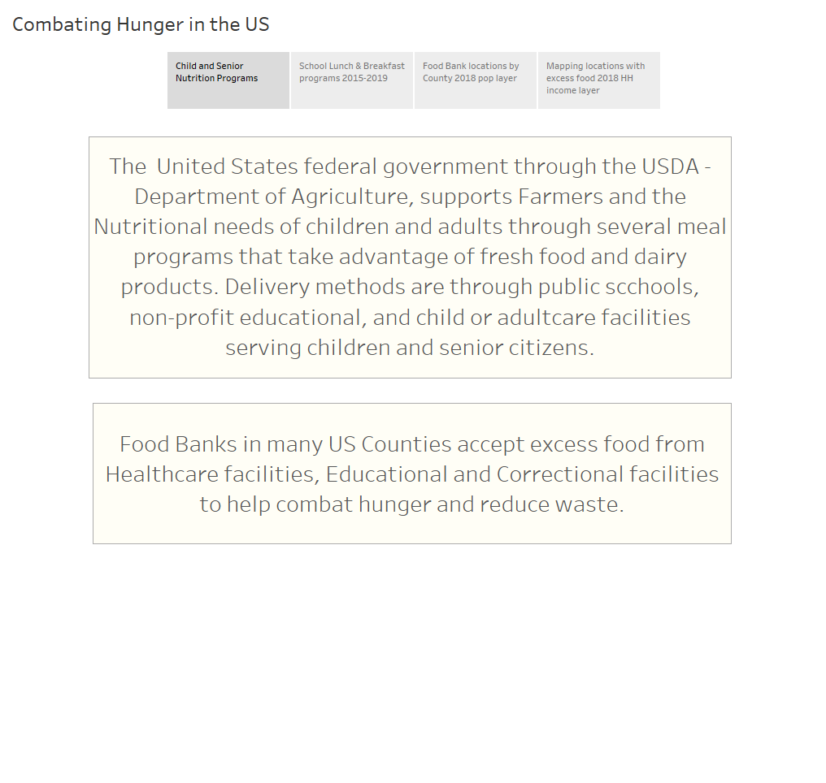

Slide 18
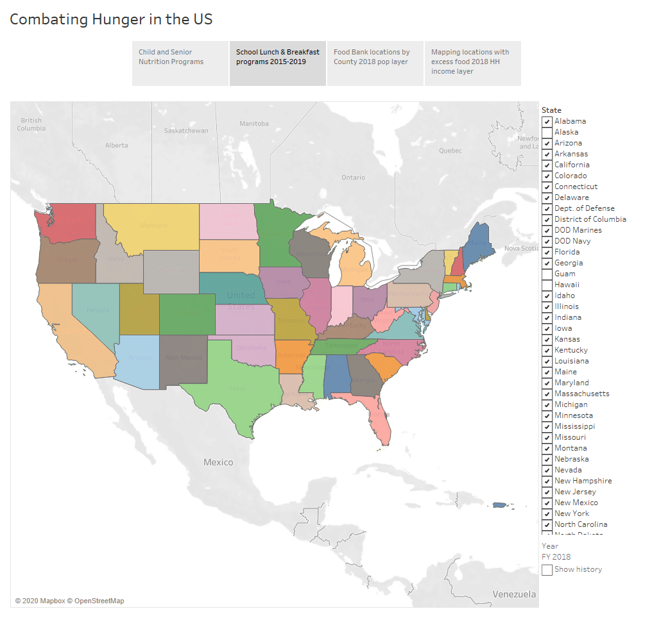

Slide 19
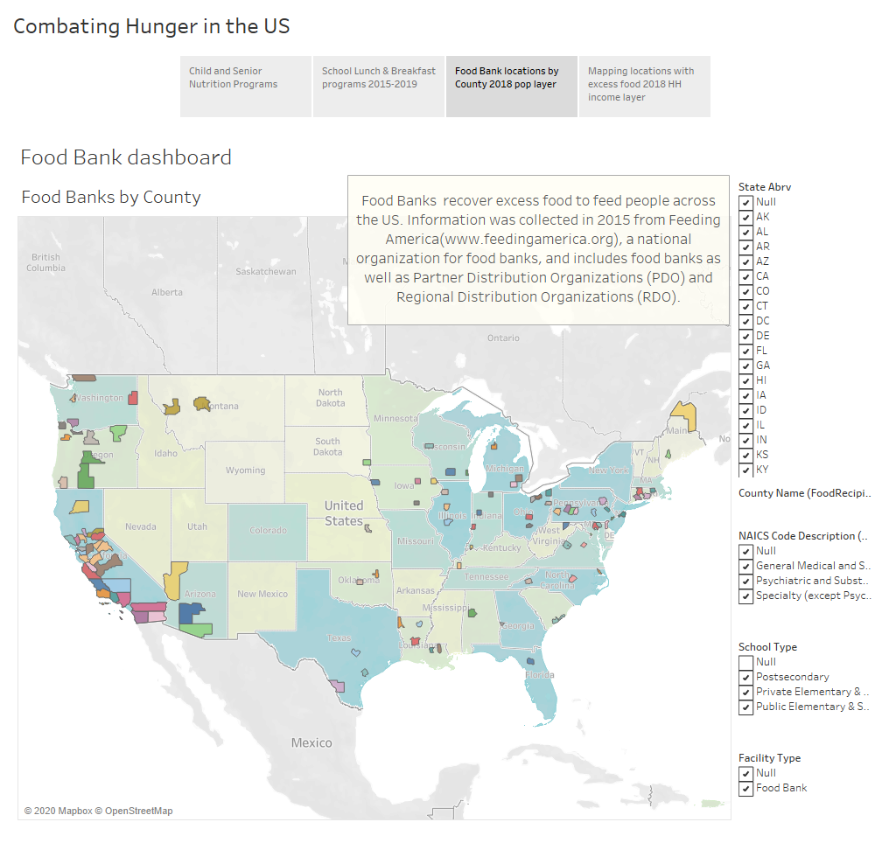

Slide 20
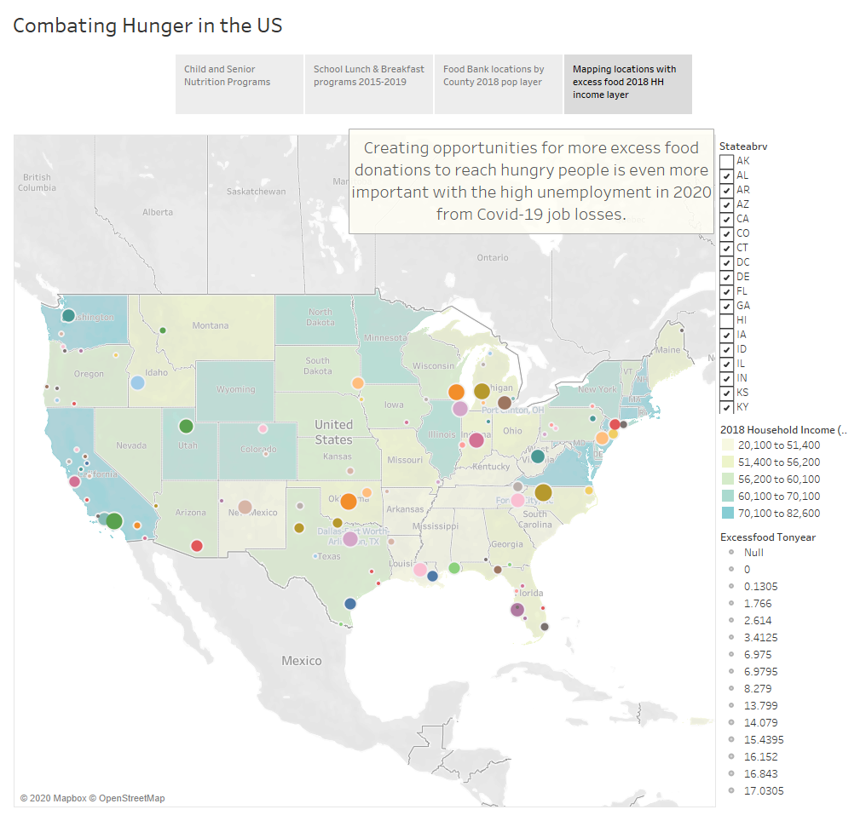

Slide 21
Sources
US Census data: https://data.census.gov/cedsci/
Used for US Population Forecast population through 2050 – web scrapping technique used: https://www.worldometers.info/world-population/us-population/
SNAP Supplemental Nutritional Assistance Program
Snap program data page
https://www.fns.usda.gov/research-analysis
https://www.fns.usda.gov/pd/child-nutrition-tables
WIC
https://www.fns.usda.gov/wic/frequently-asked-questions-about-wic

Slide 22
Sources
National School Lunch Program
The National School Lunch Program (NSLP) is a federally assisted meal program operating in public and nonprofit private schools and residential child care institutions. It provides nutritionally balanced, low-cost or free lunches to children each school day. The program was established under the National School Lunch Act, signed by President Harry Truman in 1946.
School Breakfast Program
The School Breakfast Program (SBP) provides reimbursement to states to operate nonprofit breakfast programs in schools and residential childcare institutions. The Food and Nutrition Service administers the SBP at the federal level. State education agencies administer the SBP at the state level, and local school food authorities operate the program in schools.
Summer Food Service Program
The Summer Food Service Program (SFSP) is a federally-funded, state-administered program. SFSP reimburses program operators who serve free healthy meals and snacks to children and teens in low-income areas.
From <https://www.fns.usda.gov/cn>

Slide 23
Sources
Special Milk Program
The Special Milk Program (SMP) provides milk to children in schools and childcare institutions who do not participate in other federal meal service programs. The program reimburses schools for the milk they serve. Schools in the National School Lunch or School Breakfast Programs may also participate in the Special Milk Program to provide milk to children in half-day pre-kindergarten and kindergarten programs where children do not have access to the school meal programs.
Child and Adult Care Food Program
The Child and Adult Care Food Program (CACFP) is a federal program that provides reimbursements for nutritious meals and snacks to eligible children and adults who are enrolled for care at participating child care centers, day care homes, and adult day care centers. CACFP also provides reimbursements for meals served to children and youth participating in afterschool care programs, children residing in emergency shelters, adults over the age of 60 or living with a disability and enrolled in day care facilities. CACFP contributes to the wellness, healthy growth, and development of young children and adults in the United States.

Slide 24
CRISPR-Cas9 is a method for quickly and accurately editing the genome of virtually any living thing. Using custom-built guide RNA paired with a cutting enzyme (Cas9), it can find and snip a selected sequence of DNA or RNA, eliminating or replacing a “bad” gene. Since it was first described, in late 2012, CRISPR has drastically accelerated the scope of research and moved into practical applications in medicine. So far in 2020, there are 15 trials underway. In medicine, where new drugs take a decade or more to develop, that’s game changing.
From <https://geneticliteracyproject.org/2020/06/12/infographic-what-crispr-is-curing-in-2020/>

